Slide 1



MicrotronAI
HEAT
Hawk1
Cutting Edge Droid Design

Slide 2
Our Company
Microtron Corporation is a leader in Artificial Intelligence (AI), specializing in Autonomous Systems and Machine Learning (ML) solutions. We offer expert consulting in Data Analytics, Internet of Things (IoT), and Natural Language Processing (NLP), tailored to meet government specifications and ensure compliance with federal requirements. Our extensive expertise spans government, military, healthcare, and academia, where we provide advanced concept design and technology development. By collaborating closely with industry partners, we drive innovation, enhance operational efficiency, and supporting mission-critical applications throughout all 5 phases of the DoD Acquisition Life Cycle

Slide 3




Our Team
At Microtron, we are dedicated to pushing the boundaries of technological innovation, empowering our clients with intelligent solutions that drive progress and success in an ever-evolving landscape.
Bisa Peterson
Kyndall Fry
Wilshem Pennick
Parker Bidigare
CEO
SR. DATA SCIENTIST
CORPORATE ADVOCATE & LAISON
CTO

Slide 4
About Heat Hawk 1
Introducing a cutting-edge droid designed specifically for firefighting operations. Constructed from high-strength, heat-resistant metals, this drone is engineered to withstand extreme temperatures and harsh conditions.

Slide 5
Feature Overview
Toxicity Detection
04
Advanced Fire Detection
01
Integrated sensors measure and report toxin levels, sending precise readings to a remote control unit for immediate assessment.
Equipped with a high-resolution camera to accurately locate fires within buildings, even through smoke.
Enhanced Visibility
05
Advanced Stabilization
Features night vision capabilities and smoke-penetrating optics to deliver clear, live footage during night operations and through dense smoke.
02
Equipped with cutting-edge stabilization technology to maintain a level and stable flight even in the presence of strong air currents and blast waves, ensuring reliable performance and clear data capture.
Infared Thermal Imaging
06
Enables detection of heat signatures and hotspots, assisting firefighters in locating victims and assessing fire severity even in smoke and darkness.
Building Mapping Technology
03
Safety Tags
Utilizes sophisticated mapping technology similar to that used in robotic vacuums or advanced echolocation systems, providing detailed floor plans and real-time building layouts for firefighters.
07
Provides location tracking on a tablet map powered by echolocation technology. Additionally, it monitors vital signs—heart rate, respiration rate, and blood oxygen levels. If the user loses consciousness, the tag alerts the tablet's operator, enabling prompt dispatch of a rescue team to their exact location.

Slide 6
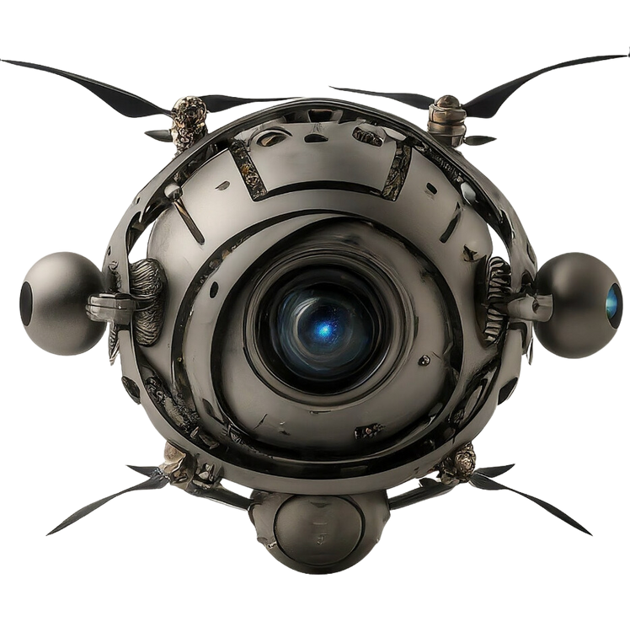
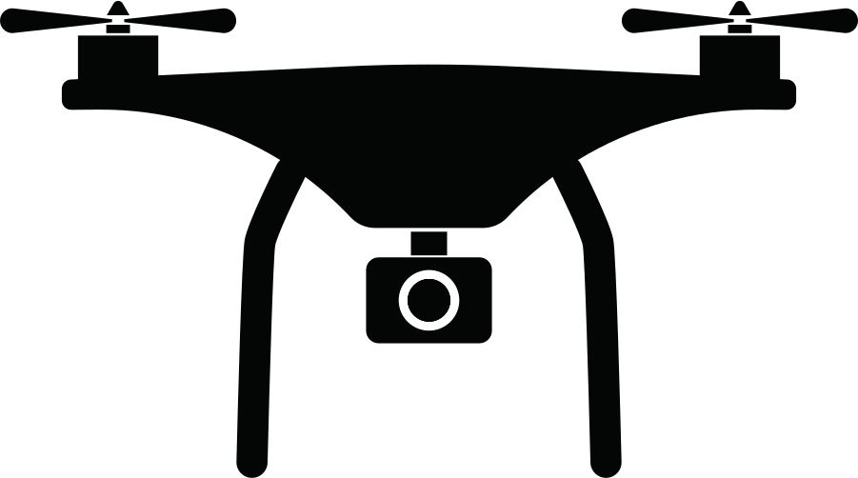

Advanced Fire Detection
Multi-Spectrum Cameras: Combining visible light, thermal, and infrared to detect fire signatures and identify hot spots even through smoke. Machine learning algorithms can be applied to classify and pinpoint fire sources based on heat intensity, size, and movement patterns.
Visible
Thermal
Infared

Slide 7


Advanced Stabilization
Integrated cutting-edge vibration sensors strategically placed in multiple directions around the droid. These sensors will detect and analyze structural instability caused by environmental factors such as strong winds, seismic activity, and explosions. By capturing real-time data on vibrations and pressure waves before they impact the building, the system ensures early detection of potential hazards, enabling immediate response and safeguarding structural integrity.
Vibration
Sensors
Multi-directional stability

Slide 8
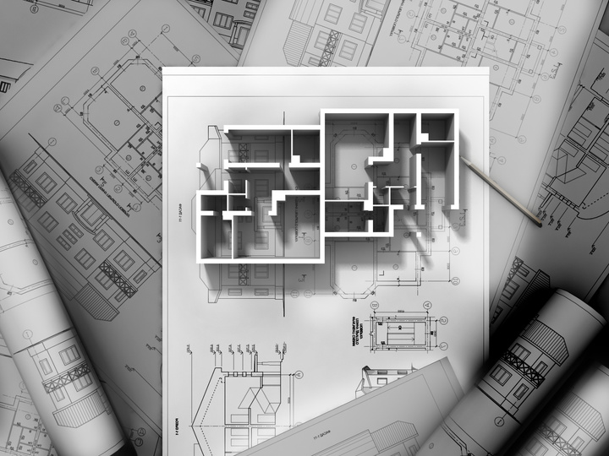
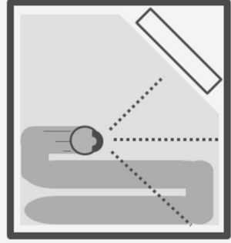
Building Mapping Technology
Deploying SLAM algorithms to build real-time 3D maps of the interior structure of buildings. This can help the system navigate in low visibility conditions and update the building layout as walls collapse or change due to fire.
3D Maping
SLAM Algorithms

Slide 9
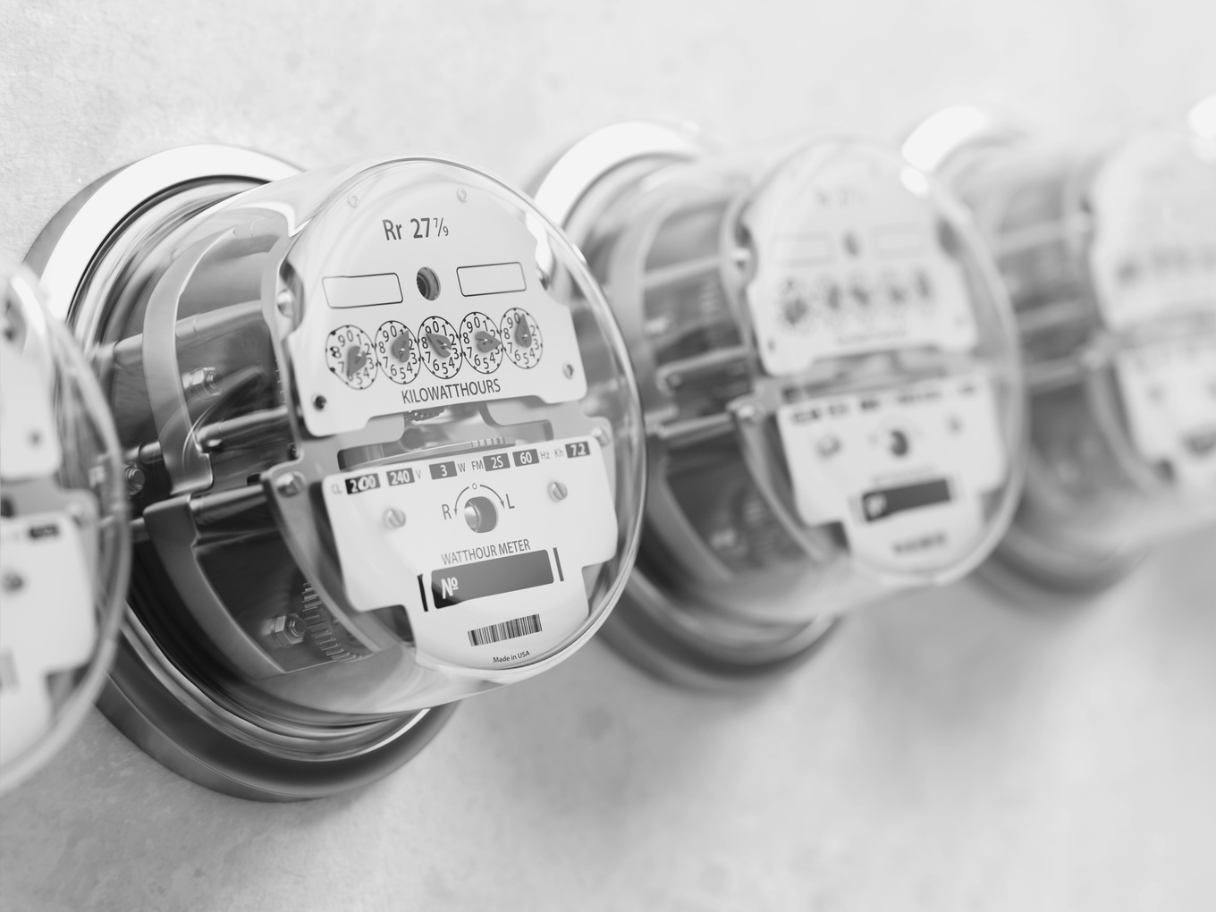

Toxicity Detection
By incorporating a suction vacuum pump with toxic air detection and purification capabilities could significantly enhance a building fire security system. The idea would involve active air sampling combined with air purification to both detect toxins and temporarily clean the air, providing immediate relief in the case of hazardous gas leaks or fires.
Vacuum Pump
Toxicity Detector

Slide 10
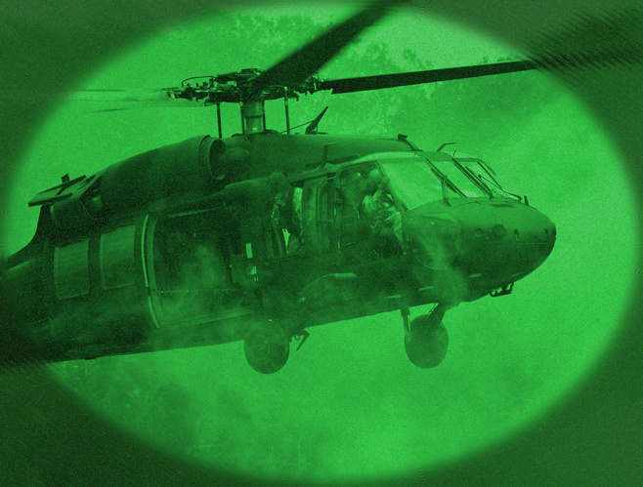

Enhanced Visibility
Integrated infrared night vision, thermal imaging, and LIDAR-based smoke-penetrating optics to provide clear, real-time footage in low-light and smoke-filled environments. Advanced AI-driven image processing adapts to conditions, ensuring optimal clarity by dynamically switching between night vision and thermal modes.
Night Vision
LIDAR Optics
SAR

Slide 11
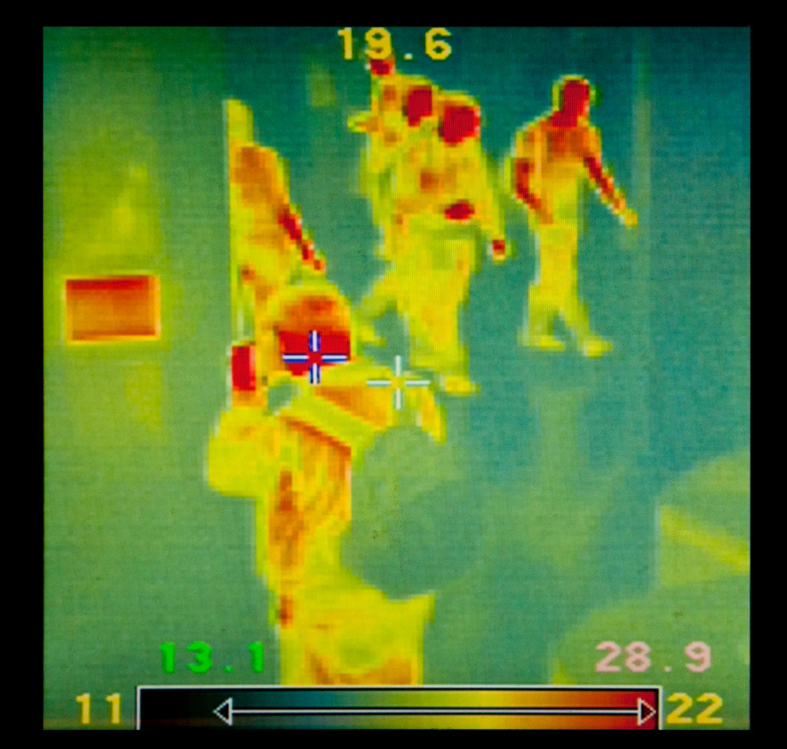
Infrared Thermal Imaging
Enables detection of heat signatures and hotspots, assisting firefighters in locating victims and assessing fire severity even in smoke, darkness and in large outdoor search areas.
Thermal Imaging

Slide 12
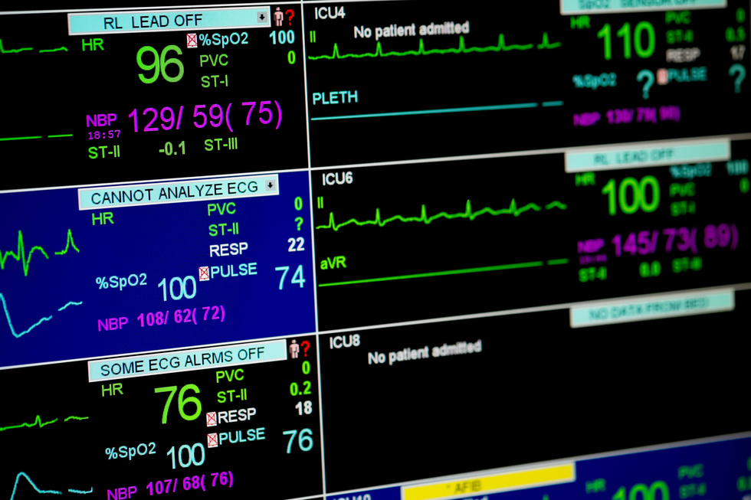
Safety Tags
Each user or firefighter will wear a tag in their uniform that functions similar to an applewatch/air tag. This tag will transmit their location to a tablet that controls the droid. The tablet will display a map, generated by echolocation technology, showing the real-time positions of each firefighter. Additionally, the tag will monitor heart rate, respiration rate, and blood oxygen levels, allowing any significant changes in these metrics to be visible on the tablet. If a firefighter loses consciousness, the tablet will alert the operator, enabling them to dispatch a rescue team to the exact location.
Safety Tags
RFID Technology

Slide 13
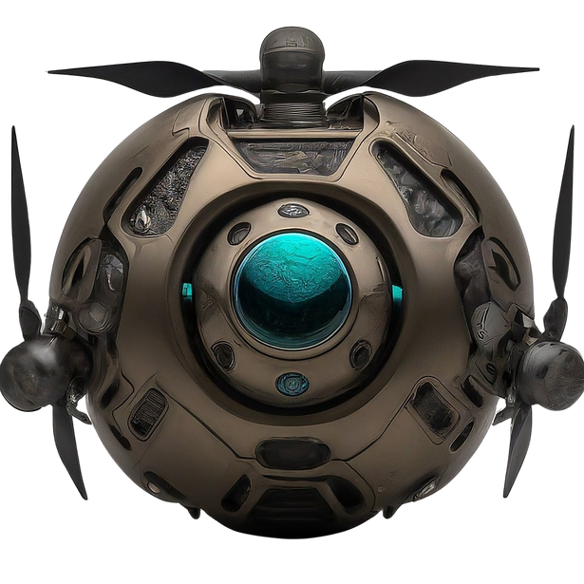
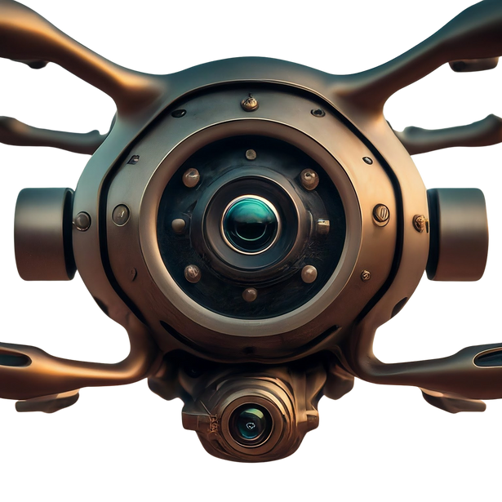
Prototypes
A
B
C

Slide 14
Development Stages
01
02
03
04
05
  Material Solutions Analysis (MSA)
  Technology Maturation & Risk Reduction (TMRR)
  Engineering & Manufacturing Development (EMD)
  Production & Deployment (P&D)
  Operations & Support (O&S)

Slide 15



Project Goals
RELIABILITY
SAFETY
PERFORMANCE

Slide 16
Thank You!
www.microtronai.com
813-894-5005
Info@microtronai.com

